Slide 1
RECITATION 2: Data quality
15.774/780 (Fall 2021)

Slide 2
Announcements
HW1 posted and due next Friday 9/24 at 5pm
Make sure you’ve installed DMwR (instructions on Canvas)
Office hours:
Monday. 5:00-6:00pm in E62-565 (Mohammad)
Wednesday 4:30-5:30pm in E51-242 (Ted)
Thursday 5:00-6:00pm in E51-242 (Doron)
Notes:
Write formulas on the board before class

Slide 3
Agenda
Data inconsistencies
Missing values & imputation
Outlier detection
Notes:
Write formulas on the board before class

Slide 4
What a mess…
Missing values (NAs) due to bad entry, or not applicable
Missing student name on Canvas
Course number for the Operations Research Center ☹
Inconsistencies things that are clearly bad data
Percentage grade is “A+”
Daily temperature of 78C
Cholesterol is over 9000
Outliers real data, just surprising/uncommon
Grade of 30 when the average was 90 +/-10
Cholesterol of 280
Notes:
Write formulas on the board before class

Slide 5
Dealing with messy data
Very subjective process…
Remove NAs or impute them?
Manually correct inconsistencies, or treat as NA?
What is an outlier for your analysis? Cap or treat as NA?
Do everything (within reason) to not throw out data.
More data, more model power.
If patterns are not random, removing data can introduce bias.
Notes:
Write formulas on the board before class

Slide 6
To R!
Notes:
Write formulas on the board before class

Slide 7
Outliers
There’s different ways to define outliers…
Univariate: is value in the “typical” range?
Use a histogram or boxplot
Bivariate: is value “typical” after accounting for 2nd variable?
Side-by-side boxplots or regression
Multivariate (time-permitting):
Cook’s distance
Notes:
Write formulas on the board before class

Slide 8
Univariate approach
Look at the distribution. Are there weird tails?
Notes:
Write formulas on the board before class

Slide 9

Univariate approach
Use Interquartile Range (IQR) as “reasonable” variance.
Identify outliers as:
Below Q₁ – 1.5IQR
Above Q₃ + 1.5IQR
min
Q₁
med
Q₃
max
outliers
IQR
Notes:
Write formulas on the board before class

Slide 10
Bivariate approach (categorical)
If different groups, consider side-by-side boxplots:
Notes:
Write formulas on the board before class

Slide 11
Bivariate approach (continuous)
Points are in reasonable range for X/Y individually
But they might not fit the observed relationship
Notes:
Write formulas on the board before class

Slide 12
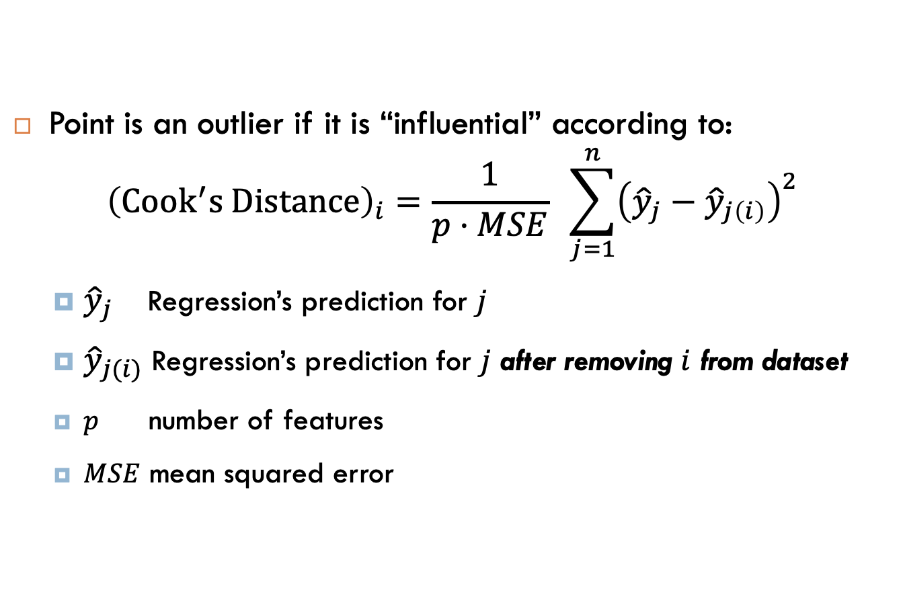

Multivariate (Cook’s distance)
Point is an outlier if it is “influential” according to:
$${\left(Cook^{′}s Distance\right)}_{i}=\frac{1}{p⋅MSE} \sum_{j=1}^{n}{{\left({\hat{y}}_{j}−{\hat{y}}_{j\left(i\right)}\right)}^{2}}$$
${\hat{y}}_{j}$ Regression’s prediction for $j$
${\hat{y}}_{j(i)}$ Regression’s prediction for $j$ after removing $i$ from dataset
$p$ number of features
$MSE$ mean squared error
Intuition: high $D_{i}⇒$ really changes model prediction
Notes:
Write formulas on the board before class

Slide 13
Cook’s distance illustration
Red point has very high influence
Removing it really changes prediction for other points
Notes:
Write formulas on the board before class

